Slide 1
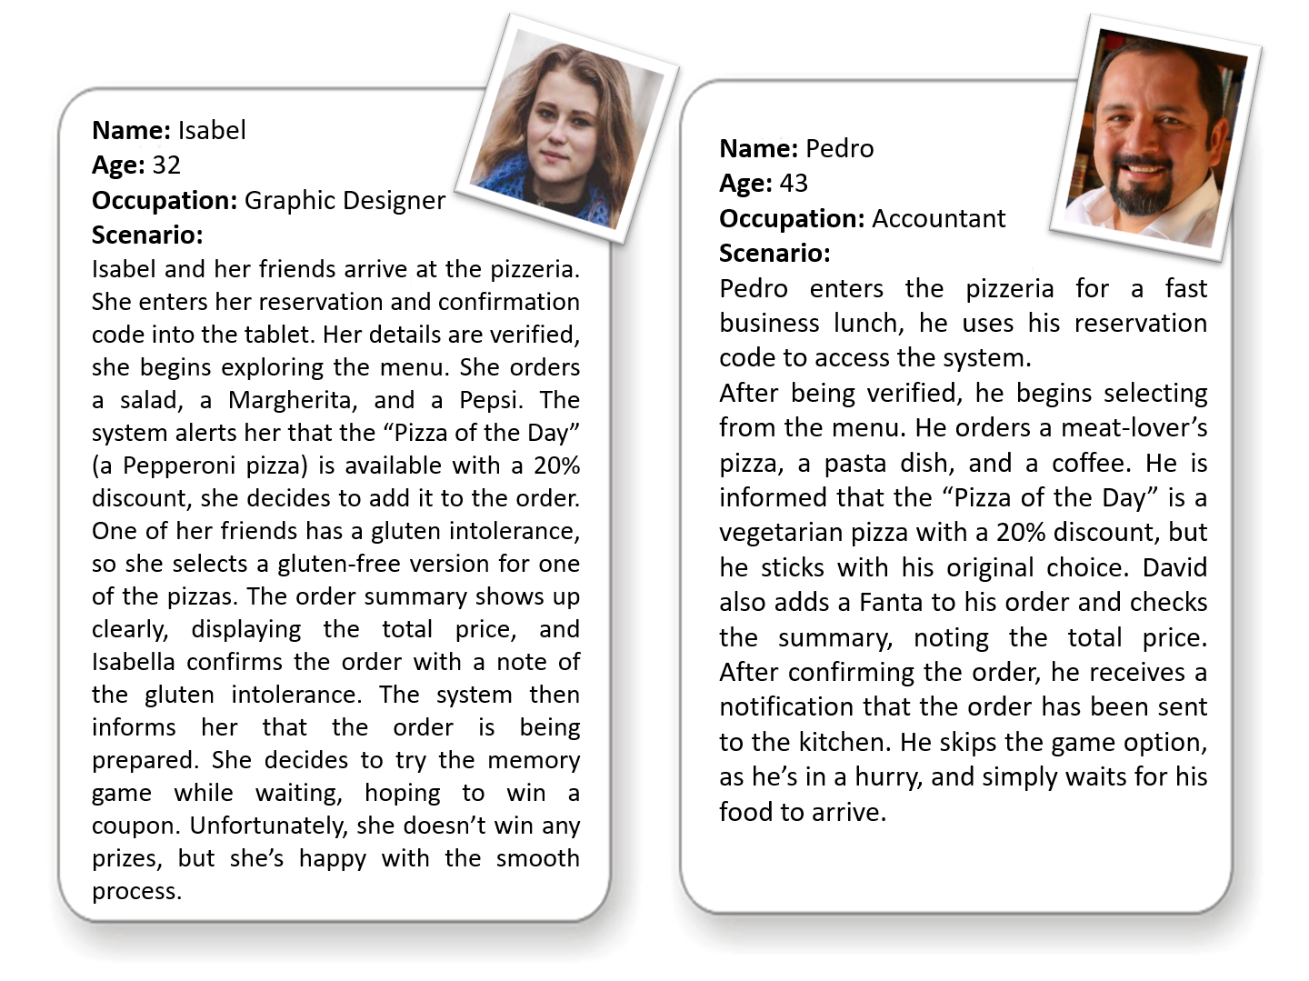


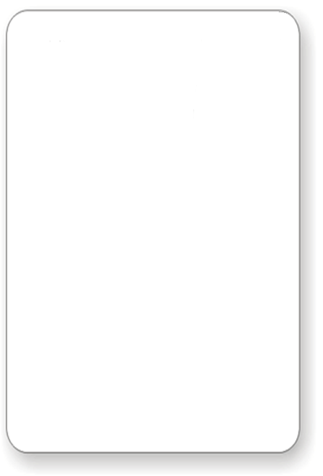
Name: Isabel
Age: 32
Occupation: Graphic Designer
Scenario:
Isabel and her friends arrive at the pizzeria. She enters her reservation and confirmation code into the tablet. Her details are verified, she begins exploring the menu. She orders a salad, a Margherita, and a Pepsi. The system alerts her that the “Pizza of the Day” (a Pepperoni pizza) is available with a 20% discount, she decides to add it to the order. One of her friends has a gluten intolerance, so she selects a gluten-free version for one of the pizzas. The order summary shows up clearly, displaying the total price, and Isabella confirms the order with a note of the gluten intolerance. The system then informs her that the order is being prepared. She decides to try the memory game while waiting, hoping to win a coupon. Unfortunately, she doesn’t win any prizes, but she’s happy with the smooth process.
Name: Pedro
Age: 43
Occupation: Accountant
Scenario:
Pedro enters the pizzeria for a fast business lunch, he uses his reservation code to access the system.
After being verified, he begins selecting from the menu. He orders a meat-lover’s pizza, a pasta dish, and a coffee. He is informed that the “Pizza of the Day” is a vegetarian pizza with a 20% discount, but he sticks with his original choice. David also adds a Fanta to his order and checks the summary, noting the total price. After confirming the order, he receives a notification that the order has been sent to the kitchen. He skips the game option, as he’s in a hurry, and simply waits for his food to arrive.

Slide 2
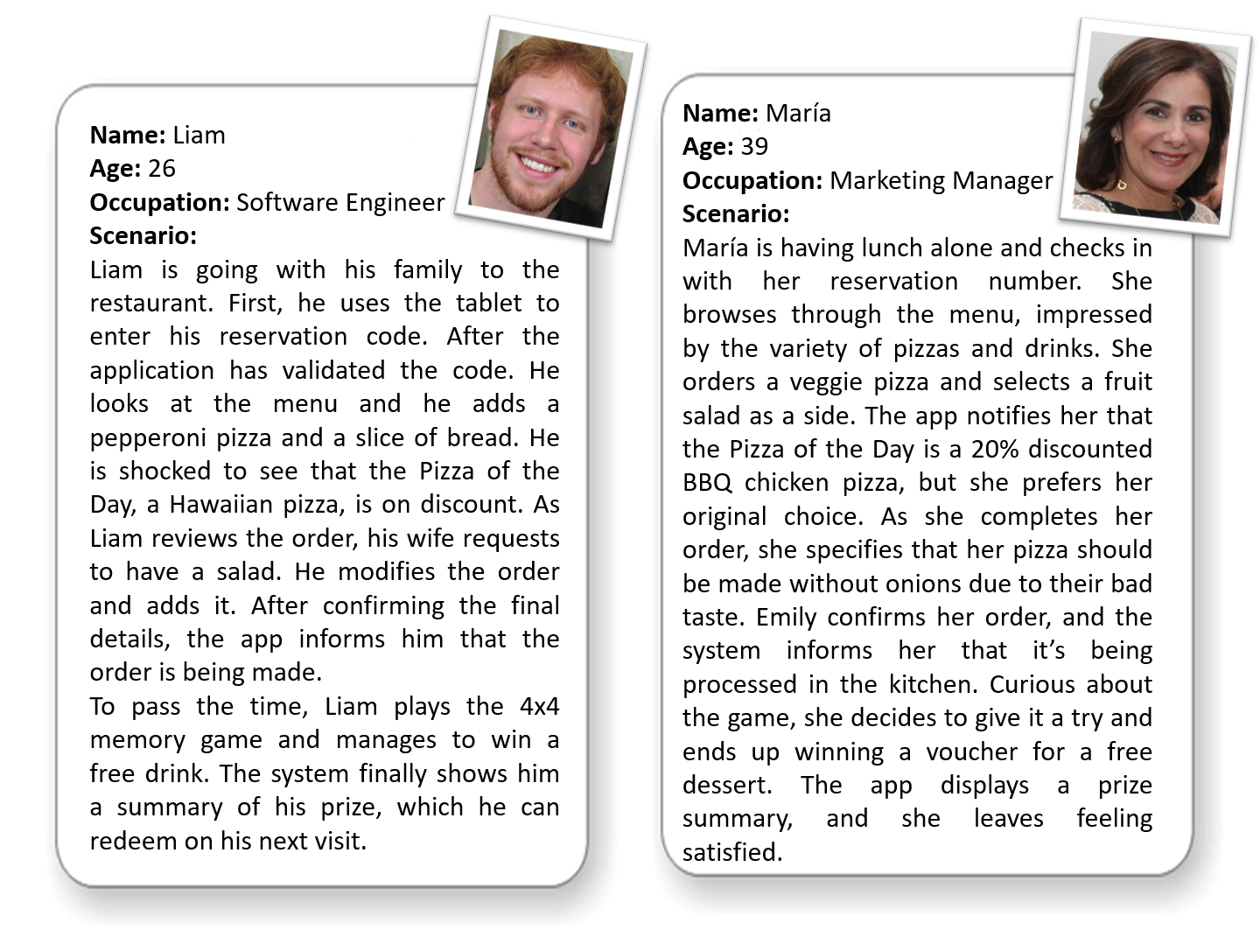


Name: María
Age: 39
Occupation: Marketing Manager
Scenario:
María is having lunch alone and checks in with her reservation number. She browses through the menu, impressed by the variety of pizzas and drinks. She orders a veggie pizza and selects a fruit salad as a side. The app notifies her that the Pizza of the Day is a 20% discounted BBQ chicken pizza, but she prefers her original choice. As she completes her order, she specifies that her pizza should be made without onions due to their bad taste. Emily confirms her order, and the system informs her that it’s being processed in the kitchen. Curious about the game, she decides to give it a try and ends up winning a voucher for a free dessert. The app displays a prize summary, and she leaves feeling satisfied.
Name: Liam
Age: 26
Occupation: Software Engineer
Scenario:
Liam is going with his family to the restaurant. First, he uses the tablet to enter his reservation code. After the application has validated the code. He looks at the menu and he adds a pepperoni pizza and a slice of bread. He is shocked to see that the Pizza of the Day, a Hawaiian pizza, is on discount. As Liam reviews the order, his wife requests to have a salad. He modifies the order and adds it. After confirming the final details, the app informs him that the order is being made.
To pass the time, Liam plays the 4x4 memory game and manages to win a free drink. The system finally shows him a summary of his prize, which he can redeem on his next visit.

